Slide 1
Experiment No. 1
Problem Definition: 1. Develop and demonstrate a XHTML file that includes Javascript script for the following problems:
a) Input: A number n obtained using prompt
Output: The first n Fibonacci numbers
b) Input: A number n obtained using prompt
Output: A table of numbers from 1 to n and their squares using
alert
CSE@GIT
Department of Computer Science and Engineering, GIT
<number>

Slide 2
Objectives of the Experiment:
To demonstrate the use of XHTML and JavaScript
To develop an understanding of JavaScript syntax
CSE@GIT
Department of Computer Science and Engineering, GIT
<number>

Slide 3
Need of the Experiment
JavaScript allows you to build interactive websites
JavaScript has become an essential web technology along with HTML and CSS, as most browsers implement JavaScript
For web development, as a front-end developer or on using JavaScript for backend development
JavaScript usage has now extended to mobile app development, desktop app development, and game development
Department of Computer Science and Engineering, GIT
<number>

Slide 4
Theoretical Background of the Experiment
JavaScript is an interpreted, scripting language, designed to add interactivity to HTML pages
It is used in Web pages to improve the design, validate forms, detect browsers, create cookies
Most popular scripting language on the internet, and works on all major browsers like Firefox, Chrome, Opera, IE
It is usually embedded directly into HTML pages
Can be used without purchasing a license
JavaScript
Department of Computer Science and Engineering, GIT
<number>

Slide 5
Theoretical Background of the Experiment
JavaScript
JavaScript created by Netscape
Joint Development with Sun Microsystems in 1995
JScript created by Microsoft
IE and Netscape renderings are slightly different
Standardized by European Computer Manufacturers Association (ECMA) - http://www.ecma-international. org/publications /standards/Ecma-262.htm
Department of Computer Science and Engineering, GIT
<number>

Slide 6
Theoretical Background of the Experiment
Uses of JavaScript
Provide alternative to server-side programming , Servers - often overloaded , Client processing - quicker reaction time
JavaScript can work with forms
Event-Driven Computation - a JavaScript program could validate data in a form before it is submitted to a server
JavaScript can interact with the internal model of the web page (Document Object Model)
JavaScript is used to provide more complex user interface than plain forms with HTML/CSS can provide
Department of Computer Science and Engineering, GIT
<number>

Slide 7
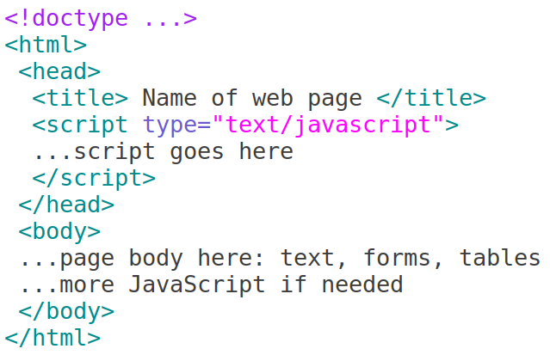
JavaScript – General Format
Directly embedded
Department of Computer Science and Engineering, GIT
<number>

Slide 8
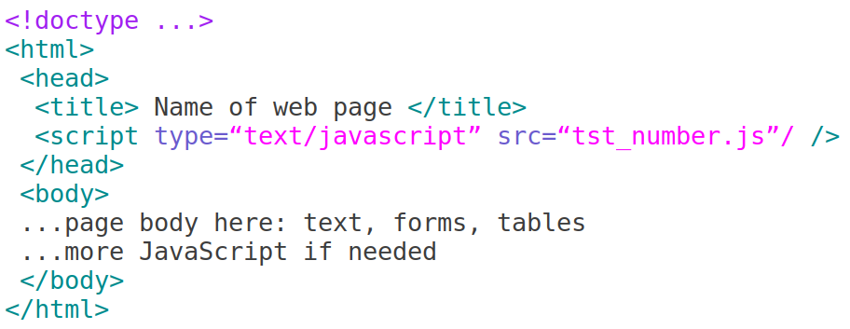
JavaScript – General Format
Indirect reference
Department of Computer Science and Engineering, GIT
<number>

Slide 9
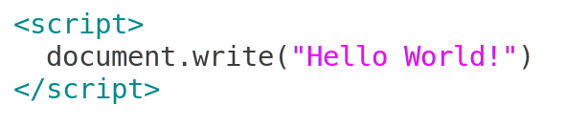
Ending Statements With a Semicolon?
JavaScript Basic Examples
With traditional programming languages, like C++ and Java, each code statement has to end with a semicolon (;).
Many programmers continue this habit when writing JavaScript, but in general, semicolons are optional! However, semicolons are required if you want to put more than one statement on a single line.
⇒ format text with HTML code - heading
Department of Computer Science and Engineering, GIT

Slide 10
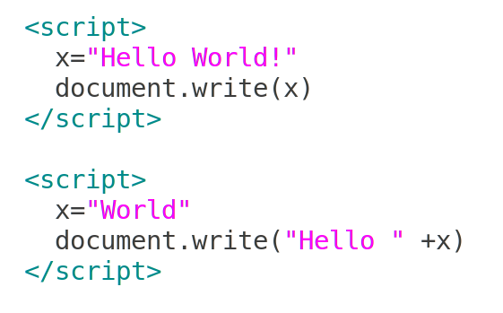
How to Put a JavaScript Into an HTML Page?
Example
<html>
<body>
<script type="text/javascript">
document.write("Hello World!")
</script>
</body>
</html>
Department of Computer Science and Engineering, GIT

Slide 11
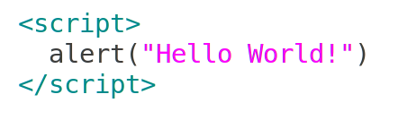
How to Put a JavaScript Into an HTML Page?
JavaScript Popup Boxes - alert
<html>
<body>
<script type="text/javascript">
document.write("Hello World!")
</script>
</body>
</html>
Alert Box
An alert box is used if you want to make sure information comes through to the user.
When an alert box pops up, the user will have to click "OK" to proceed.
Department of Computer Science and Engineering, GIT

Slide 12
How to Put a JavaScript Into an HTML Page?
JavaScript Popup Boxes - confirm
<html>
<body>
<script type="text/javascript">
document.write("Hello World!")
</script>
</body>
</html>
Confirm Box
A confirm box is used if you want the user to verify or accept something.
When a confirm box pops up, the user will have to click either "OK" or "Cancel" to proceed.
If the user clicks "OK", the box returns true. If the user clicks "Cancel", the box returns false.
Department of Computer Science and Engineering, GIT

Slide 13
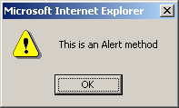
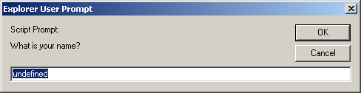
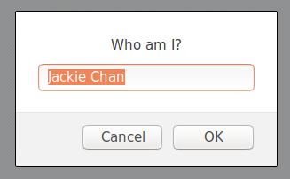
alert(), confirm(), and prompt()
<script type="text/javascript">
alert("This is an Alert method");
confirm("Do you want to continue this download?");
prompt("What is your name?");
prompt("Who am I?","Jackie Chan");
</script>

Slide 14

promt()
How to Put a JavaScript Into an HTML Page?
Return valut of promt() is the value enter in text area
On cliciking OK or pressing Enter , the value can be collected in a vairable
<html>
<body>
<script type="text/javascript">
document.write("Hello World!")
</script>
</body>
</html>
Department of Computer Science and Engineering, GIT

Slide 15
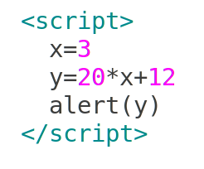
How to Put a JavaScript Into an HTML Page?
JS Examples -1
<html>
<body>
<script type="text/javascript">
document.write("Hello World!")
</script>
</body>
</html>
Assume : y =20 x + 12 ,
if x=3 then, what will be the value of y ?
Department of Computer Science and Engineering, GIT

Slide 16
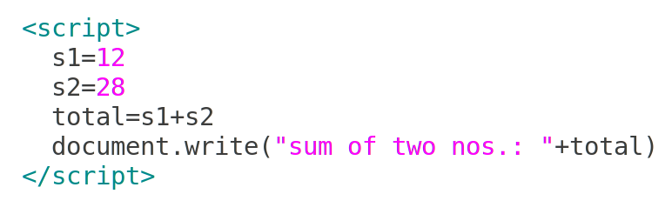
How to Put a JavaScript Into an HTML Page?
Examples -2
<html>
<body>
<script type="text/javascript">
document.write("Hello World!")
</script>
</body>
</html>
Department of Computer Science and Engineering, GIT

Slide 17

Statements and Primitive Types
How to Put a JavaScript Into an HTML Page?
Statements can be terminated with a semicolon
But, the interpreter will insert the semicolon if missing at the end of a line
Can be a problem:
If a statement must be continued to a new line, make sure that the first line does not make a complete statement by itself
Five primitive types – Number , String , Boolean , Undefined , Null
Date object
<html>
<body>
<script type="text/javascript">
document.write("Hello World!")
</script>
</body>
</html>
Department of Computer Science and Engineering, GIT

Slide 18
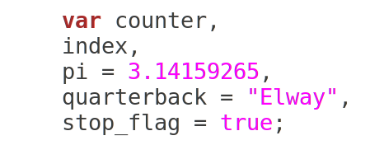
Declaring variable
How to Put a JavaScript Into an HTML Page?
Dynamically typed
<html>
<body>
<script type="text/javascript">
document.write("Hello World!")
</script>
</body>
</html>
Department of Computer Science and Engineering, GIT

Slide 19
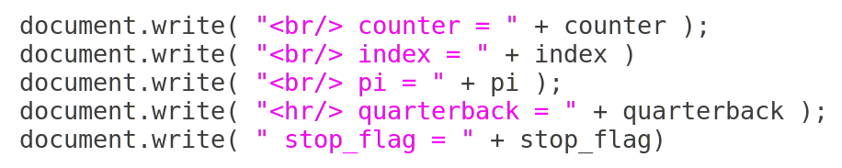
String Catenation +
How to Put a JavaScript Into an HTML Page?
+
Types automatically converted to string
Implicit , Explicit type conversion
<html>
<body>
<script type="text/javascript">
document.write("Hello World!")
</script>
</body>
</html>
Department of Computer Science and Engineering, GIT

Slide 20
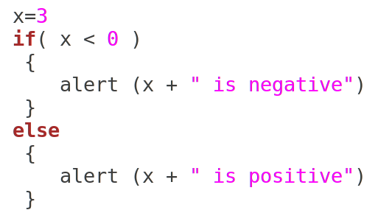
Conditional Statements
How to Put a JavaScript Into an HTML Page?
Similar to C/C++/Java
if statement
if...else statement
if...else if....else statement
switch statement
<html>
<body>
<script type="text/javascript">
document.write("Hello World!")
</script>
</body>
</html>
Department of Computer Science and Engineering, GIT

Slide 21
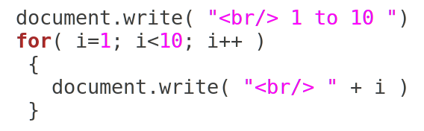
Looping Statements
How to Put a JavaScript Into an HTML Page?
Loop statements in JavaScript are similar to those in C/C++/Java
while
for
do while
<html>
<body>
<script type="text/javascript">
document.write("Hello World!")
</script>
</body>
</html>
Department of Computer Science and Engineering, GIT

Slide 22
Looping Statements – Print prime numbers
How to Put a JavaScript Into an HTML Page?
Prime number - A number that is divisible only by itself and 1
Using looping statement, find and print prime numbers from 2 to 100
<html>
<body>
<script type="text/javascript">
document.write("Hello World!")
</script>
</body>
</html>
Department of Computer Science and Engineering, GIT

Slide 23
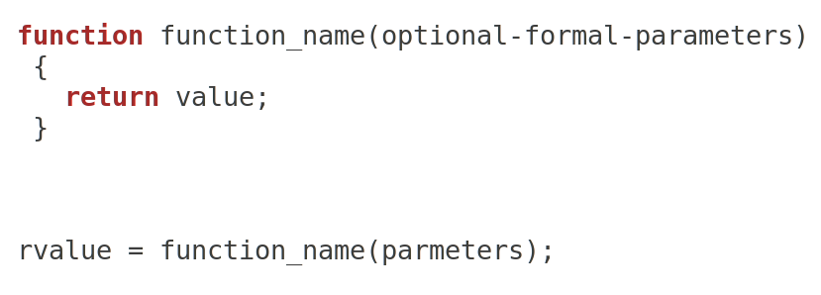
How to Put a JavaScript Into an HTML Page?
Function and Function call
Functions are objects in JavaScript
<html>
<body>
<script type="text/javascript">
document.write("Hello World!")
</script>
</body>
</html>
Department of Computer Science and Engineering, GIT

Slide 24
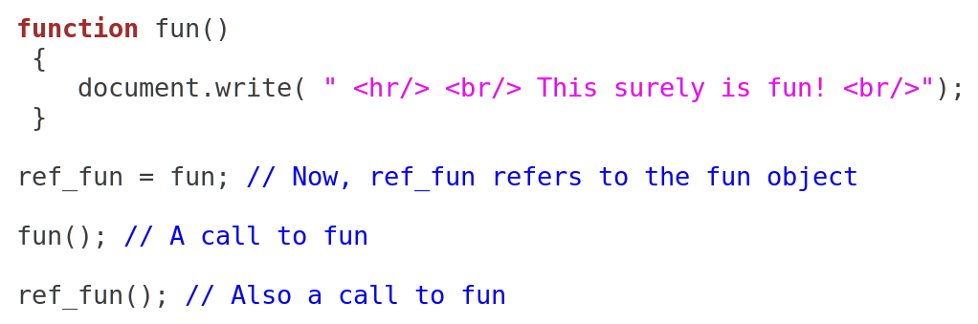
How to Put a JavaScript Into an HTML Page?
Function and Function call
Functions are objects in JavaScript
<html>
<body>
<script type="text/javascript">
document.write("Hello World!")
</script>
</body>
</html>
Department of Computer Science and Engineering, GIT

Slide 25
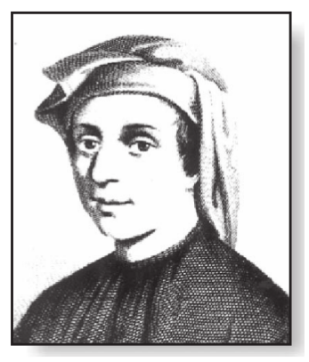
How to Put a JavaScript Into an HTML Page?
Fibonacci Numbers
Fibonacci numbers - integer sequence characterized by the fact that every number after the first two is the sum of the two preceding ones
0 , 1 , 1 , 2 , 3 , 5 , 8 . . .
F_{n} = F_{n-1} + F_{n-2}
Golden ratio
Pascal triangle
[ Leonardo Bonacci, Leonardo of Pisa, Leonardo Pisano Bigollo, or Leonardo Fibonacci;
Rosen, Kenneth H.Discrete mathematics and its applications / Kenneth H. Rosen. ]
<html>
<body>
<script type="text/javascript">
document.write("Hello World!")
</script>
</body>
</html>
Department of Computer Science and Engineering, GIT

Slide 26
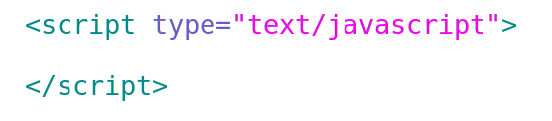
1a. Pseudo Code / Outline of the Algorithm
Fibonacci
Department of Computer Science and Engineering, GIT
<number>

Slide 27
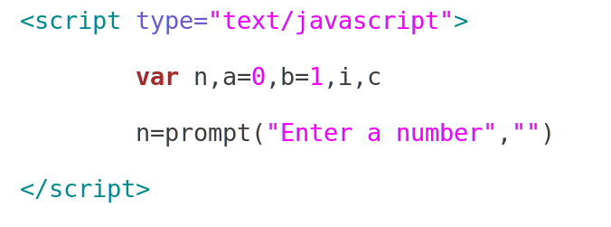
1a. Pseudo Code / Outline of the Algorithm
Fibonacci
Department of Computer Science and Engineering, GIT
<number>

Slide 28
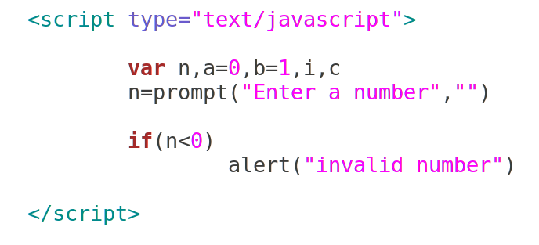
1a. Pseudo Code / Outline of the Algorithm
Fibonacci
Department of Computer Science and Engineering, GIT
<number>

Slide 29
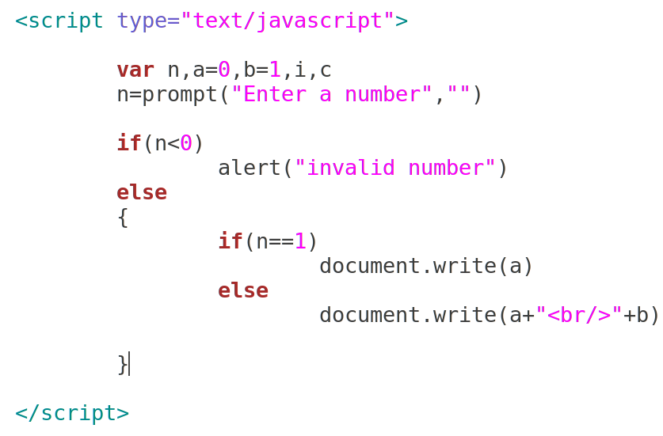
1a. Pseudo Code / Outline of the Algorithm
Department of Computer Science and Engineering, GIT
<number>

Slide 30
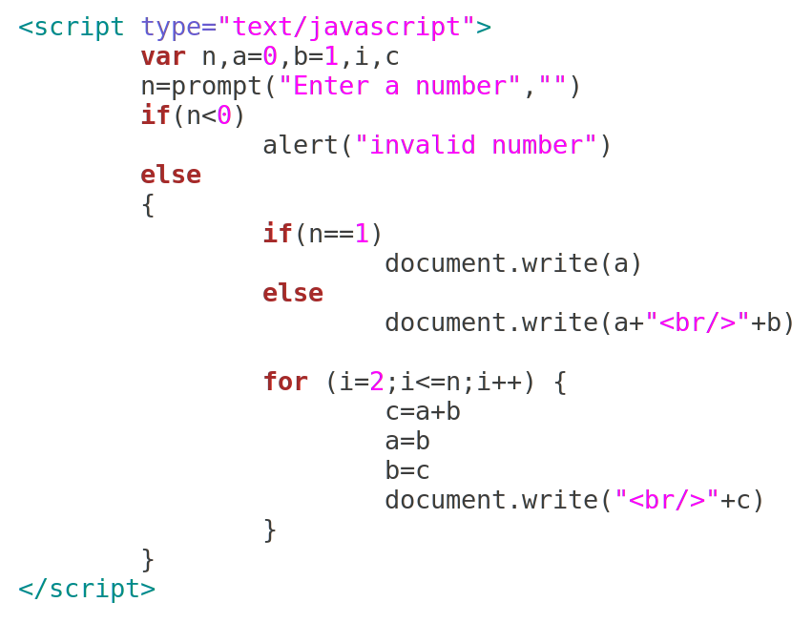
1a. Pseudo Code / Outline of the Algorithm
Department of Computer Science and Engineering, GIT
<number>

Slide 31
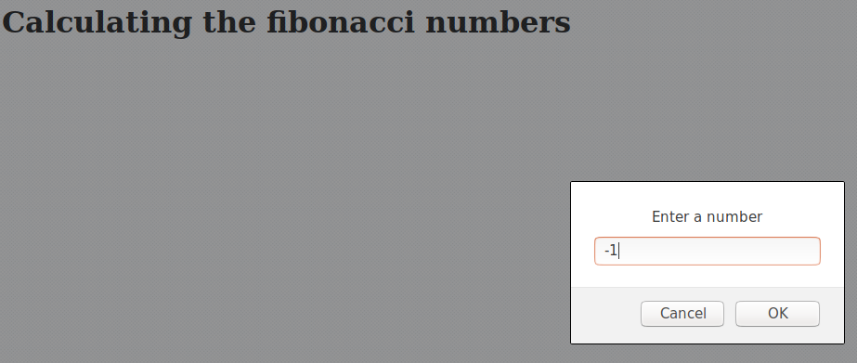
Sample Run
Department of Computer Science and Engineering, GIT
<number>

Slide 32
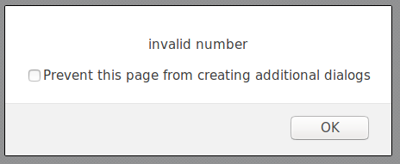
Sample Run
Department of Computer Science and Engineering, GIT
<number>

Slide 33
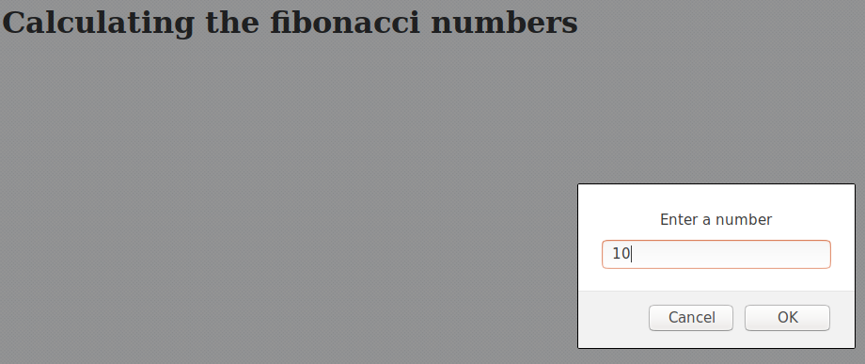
Sample Run
Department of Computer Science and Engineering, GIT
<number>

Slide 34
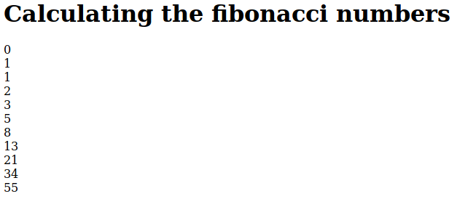
Sample Run
Department of Computer Science and Engineering, GIT
<number>

Slide 35
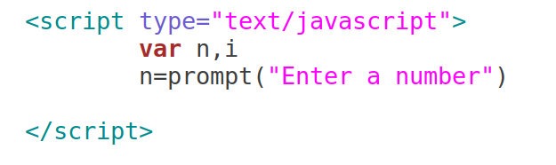
1b. Pseudo Code / Outline of the Algorithm
Squares
21/08/2017
Department of Computer Science and Engineering, GIT
<number>

Slide 36
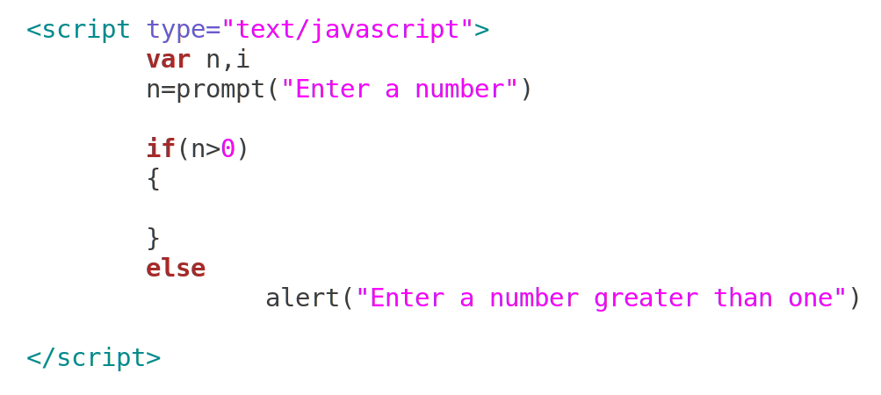
1b. Pseudo Code / Outline of the Algorithm
Squares
21/08/2017
Department of Computer Science and Engineering, GIT
<number>

Slide 37
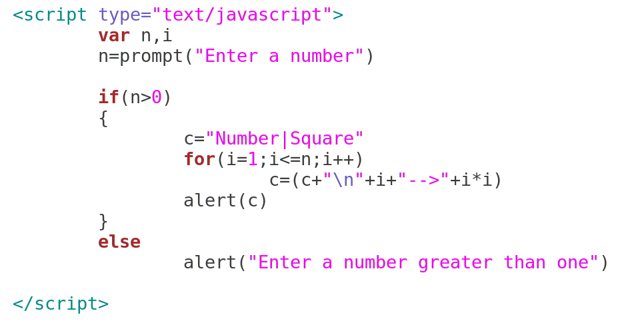
1b. Pseudo Code / Outline of the Algorithm
Squares
21/08/2017
Department of Computer Science and Engineering, GIT
<number>

Slide 38
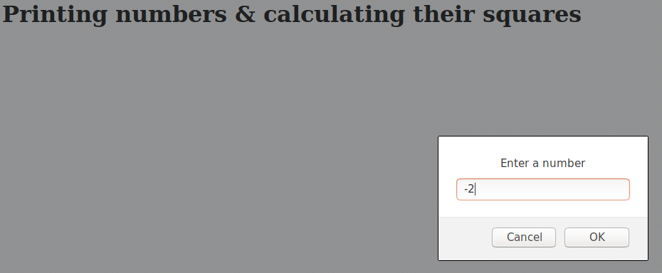
Sample Run
Department of Computer Science and Engineering, GIT
<number>

Slide 39
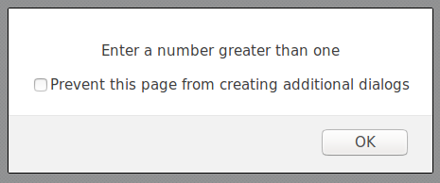
Sample Run
Department of Computer Science and Engineering, GIT
<number>

Slide 40

Sample Run
Department of Computer Science and Engineering, GIT
<number>

Slide 41
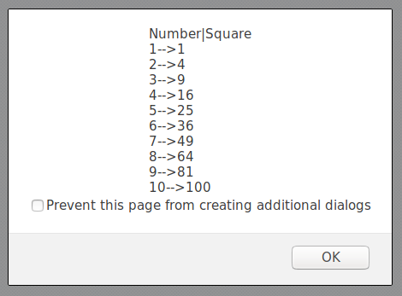
Sample Run
Department of Computer Science and Engineering, GIT
<number>

Slide 42
Learning Outcomes of the Experiment
At the end of the session, students should be able to :
1) Explain the features of Javascript. [L2]
2) Experiment with the usage of basic programming concepts like variables,
data types and conditional and looping statements [L3]
Department of Computer Science and Engineering, GIT
<number>

Slide 43

How to Put a JavaScript Into an HTML Page?
Firebug
[ http://getfirebug.com/img/firebug-large.png ]
<html>
<body>
<script type="text/javascript">
document.write("Hello World!")
</script>
</body>
</html>
Department of Computer Science and Engineering, GIT

